Slide 1
Biotechnology-Applications

Slide 2
What are we doing?
Biotechnological techniques provide evidence for evolution by using PCR (to amplify minute samples of DNA to testable amounts), bacterial enzymes and gel electrophoresis to facilitate DNA sequencing of genomes
Conduct investigations, including the use of virtual or real biotechnological techniques of polymerase chain reaction (PCR), gel electrophoresis for deoxyribonucleic acid (DNA)sequencing, and techniques for relative and absolute dating, safely, competently and methodically for valid and reliable collection of data (SIS)
Describe the process of PCR
Describe the process of gel electrophoresis
Conduct valid and reliable investigations including polymerase chain reactions and gel electrophoresis for DNA sequencing

Slide 3
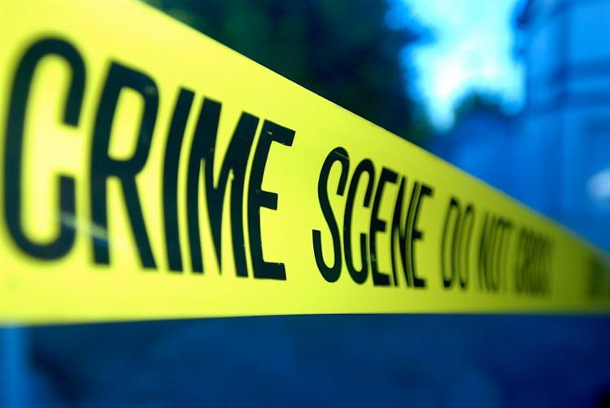

Real world Applications
Crime scene
Human relatedness
Paternity
Animal relatedness
Anthropology studies
Disease-causing organisms
Food identification
Human remains
Monitoring transplants
Notes:
These methods are used daily around the world for a variety of applications, From real crime scene investigations to paternity testing on Jeremy Kyle!

Slide 4
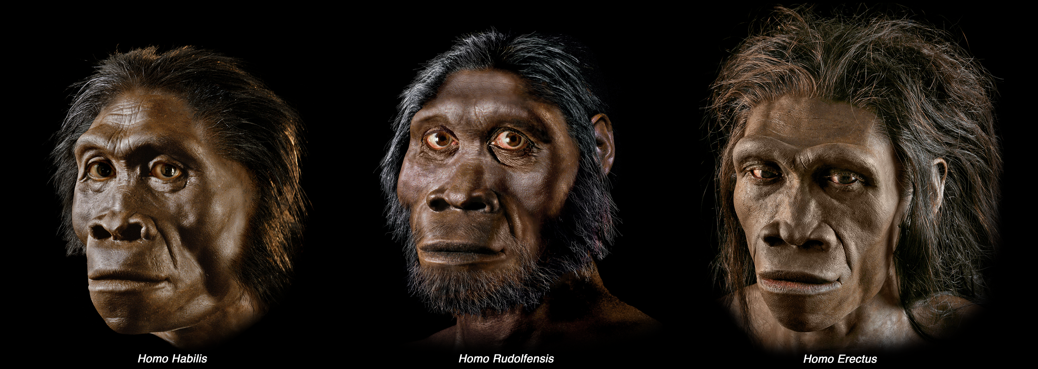
Looking for evidence
1. Collect DNA
Through cheek cell DNA extraction
Break open cells
2. Make lots of copies of DNA fragment
- Polymerase Chain Reaction
3. Visualise your DNA
- using Gel Electrophoresis
Notes:
You can use molecular biology to look at your own genes.
To do this you need to collect DNA, through cheek cell extraction, and break open the cells to release the DNA inside.
This DNA is then added to a mix of reagents, and put in the computer controlled PCR machine and heated at different temperatures, at the end of which will have created millions of copies of the specific fragment of DNA.
The copies of DNA fragment are then visualized by Gel Electrophoresis and can be used to identify someone if compared to a control.
The PCR process can be described as looking for a needle in a haystack, (ie looking for a DNA fragment in the entire genome), and then making a haystack out of that needle(from the amplifying DNA process).
This process can be used for crime scene investigations, paternity testing and gene mapping!

Slide 5
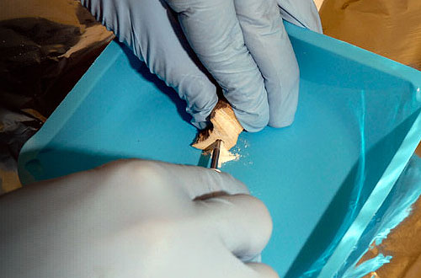

Cell extraction
First you need to collect DNA to analyse.
Cells can be collected from
Cheek
Blood
Urine
Hair follicle
Skin
Bone marrow
Notes:
So
Cheek cells are shed into your saliva all the time, normally just swallow them and they are digested. Can anyone say what effect just eating may have on collection of cells? (swallow loads of recently shed cells, and also have bits of food in saliva).
We are going to practice collecting our DNA samples.
Everyone:
Chew cheeks briefly – NO BLOOD. People with braces may find it harder.
Take in the saline solution in the cup in front of you and swill around in your mouth. Spin back into the cup.
This cup will now contain your cheek cells in your saliva. But they are suspended in the solution as WHOLE cells.

Slide 6
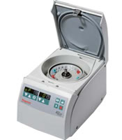
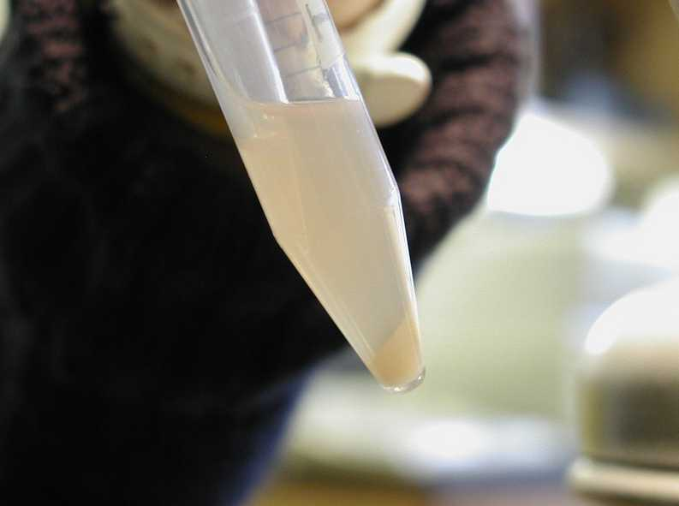
Centrifugation
Rotating force pushes cells to bottom of tube
Creates white pellet of cells
Notes:
A centrifuge is a machine that rotates the mixture extremely fast and the force will push the cells to the bottom of the tube. We don’t have time to actually do it today, so we are just going to show you. You would take some of your spit and transfer it to a microcentrifuge tube which is the right shape for the machine. It is placed inside the machine and you would put an empty sample of water- can anyone think of why this is done?
Once its spun and you would remove the sample. A white pellet of your cheek cells will form at the bottom. You would then pour off the majority of the saline at the top.

Slide 7
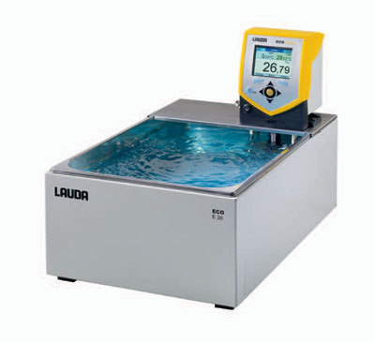
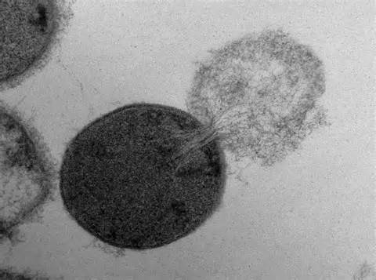
Heating your cell solution
Heat will break cells open and release DNA
Notes:
You would then take some of your centrifuged spit and add it to something called instagene matrix. This is a solution that prevents DNA from breaking down, which is important if we want to make lots of copies of it. It is microscopic beads so the solution needs to be flicked to resuspend the solution.
You would then put into a water bath to soften cell membrane and stop clumping, break the cell open to release the DNA into solution.

Slide 8
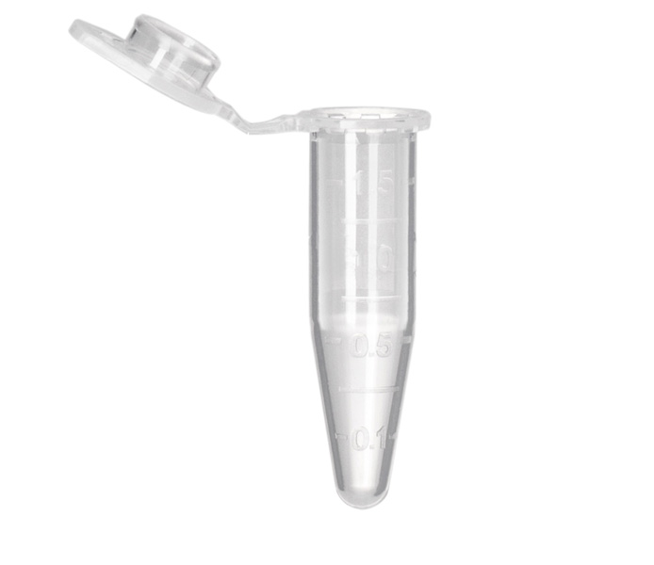
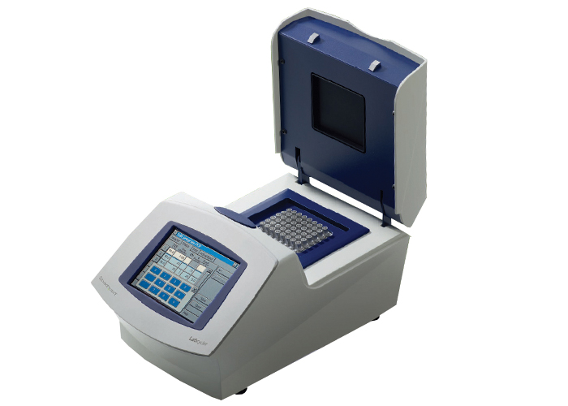
PCR Prep
VIDEO LINK
Things needed for PCR:
DNA from you
Primers
DNA polymerase (Taq)
Substrate nucleotides – dNTPs (A,T,G,C)
Buffer and ions
Notes:
PCR is basically using a computer controlled heat source, to creates millions of copies of DNA fragments. So you literally put in a tube containing your DNA which has been extracted using the method just discussed, and add it to the master mix which contains primers (set of nucleotides that bind to a specific part of the genome- this is pre-determined depending on the experiment), enzymes, and nucleotide bases.
Demonstrate: The experiment protocol is:
Using a micropipette you would then transfer 20microlitres of DNA sample from the top of the solution, as the ‘instagene beads’ will settle to the bottom and you don’t want them to enter the PCR machine.
Add 20microlitres USING A NEW PIPETTE, of the tube labelled master mix into the PCR tube. This has been pre-prepared by the lab technicians and includes the primers, nucleotides and enzymes needed. It needs to be kept on ice before the practical. You can then MIX the solution by pipetting up and down.
PCR tubes are the TINY. Can you see the difference between PCR tubes and microcentrifuge tubes? PCR tubes have extremely thin walls for heat conducting.

Slide 9
PCR Machine
Denature 94°C Breaks apart strands
Annealing 60°C Allows primer to bind
Extension 72°C DNA polymerase binds = DNA replication
Creates millions of copies of fragment of DNA
https://www.youtube.com/watch?v=iQsu3Kz9NYo
Notes:
You would then place the PCR tube in the computer and use a predefined program that would go as follows:
Strands separate at 94°C- How would this breaking occur?
Cooled to 60°C allows the primers to bind to a certain part of the sequence
At 72°C The enzyme will then bind to the primer and start DNA replication extending the replicated copies
This cycle will typically repeat approximately 40 cycles to then creates millions of copies of DNA fragment as every cycle doubles the number of DNA, creating a strong enough sample to analyse
Remember it is not the whole genome that is amplified, it is a fragment decided by the primers used that were complimentary to a specific region.
Here is a video showing the PCR process- what is actually going on in the tube inside the machine! Sorry about the music!

Slide 10
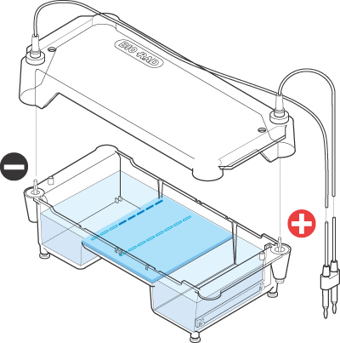

Gel Electrophoresis
https://www.youtube.com/watch?v=QEG8dz7cbnY
Notes:
So you now have a sample of millions of copies of fragments of DNA which has been loaded with orange dye. It is now able to be used in Gel Electrophoresis.

Slide 11
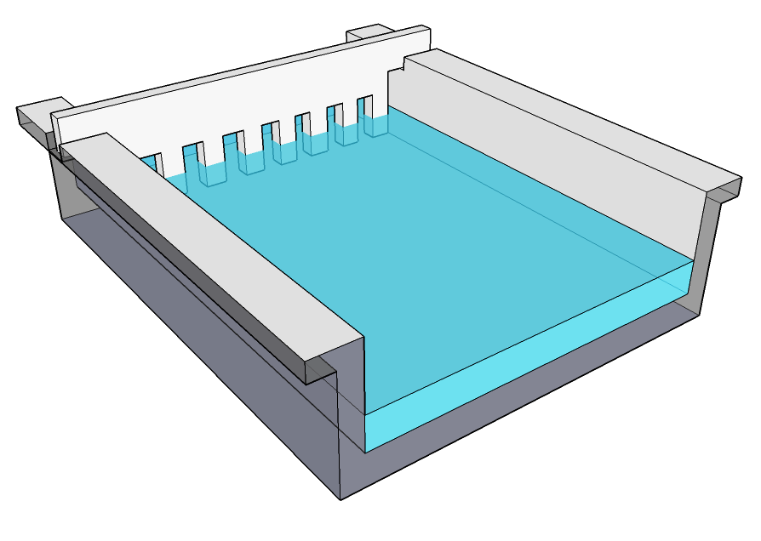
Gel Electrophoresis: Making Agarose Gel
Comb to create wells
Notes:
We have prepared these agarose gels have been prepared by us by adding a certain amount of agarose powder to the buffer to get the desired concentration, and put in the microwave to completely dissolve the powder in solution. We sealed the gel tray with these rubber seals added the well comb near one end, and in the middle and poured the agarose and left to cool down and set.

Slide 12
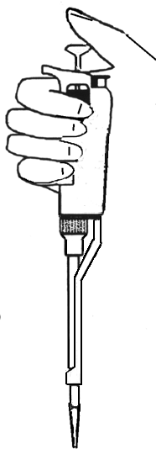
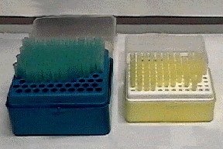

Micropipette
3 Parts: Big button, little button, dial
Push big button half way before (insert tip in liquid)
Push big button fully down to release liquid
Push small button to eject tip
Notes:
Numbers on the Micropipettes: On the P1000 micropipette divide by ten to work out the number in microlitres. For example 100 on the dial means it is set on 10 microlitres, remember microlitres has the symbol mew. For the p 20 micropipette 020 on the dial means 20microlitres.
The number of microlitres on the pipette is adjusted on the dial. Really convenient and measures very precise small quantities. Yellow tips for small quantity 20microlitres, blue for larger 200microlitres.
Hold it with fingers curled around the edge, and thumb pushing down on button.
Push the micropipette into one of the tips FIRMLY
Push the button down until you feel some resistance BEFORE putting the tip into the solution you want to take up. Put the tip in the solution but not to the bottom of the glassware. Lift out.
To release its contents, push the button the whole way down.
Tips: try not to get bubbles in the tip as then the wrong amount will be measured.
Every time you use a new solution you need a new tip to avoid cross contamination, so you push the smaller button to eject the tip straight into a biohazardous bin.

Slide 13
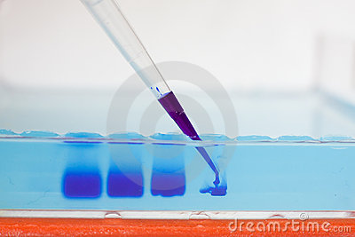
Gel Electrophoresis: Pipetting into the well
Notes:
Demonstrate: Put the gel in the gel tray. Cover with buffer solution enough to cover the wells of the gel.
Then you would put your loaded sample into each separate well in the gel: its tricky as you have to go beneath the surface of the buffer to reach them but not stab through the bottom of the gel. In the real experiment you would also add controls to the first three rows to then compare your DNA to a known result, marking exactly what had gone in each row.
Students practice now. Using the Dyed sample in PCR tube practice pipetting into the wells.

Slide 14
Gel Electrophoresis
Charge applied
DNA will move to +ve charge across gel
Small fragments move further, quicker
Notes:
So you now have a sample of millions of copies of fragments of DNA which has been loaded with orange dye. It is now able to be used in Gel Electrophoresis.
Gel electrophoresis is a way to visualize the fragments according to their size: negatively charged DNA will move towards the positive electrode the red electrode, but smaller fragments will move further quicker, creating bands. Imagine the gel to be a massive mesh: smaller fragments are able to navigate through the mesh easier and faster than larger ones.
Add the lid, add the electrode, black to black for negative charge, red to red for positive charge, and connect these to a power pack. You would then turn on the power pack to 100V, and leave for 30 mins.
The gel tray is then removed and stained with a blue dye to visualize the DNA which has moved across the Gel. The stain physically binds to the DNA to visualise it.

Slide 15
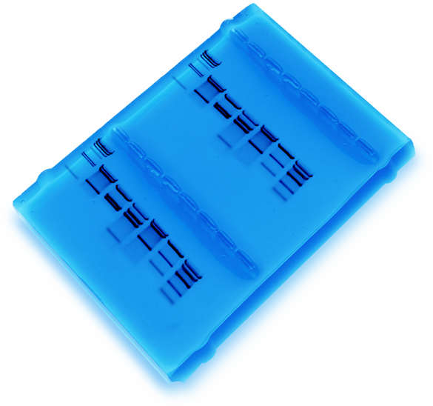
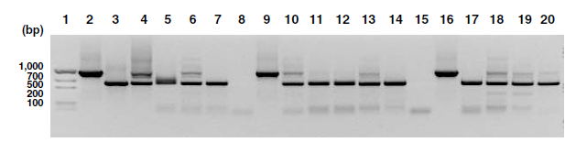
Gel Electrophoresis
Banding
Pattern can be compared to controls
Notes:
This is a typical stained gel. See that the bands have moved away from the wells, to the negative end. Notice the banding patterns? By comparing your DNA to known controls, you can learn about the length of DNA fragment and determine paternity and disease.

